Slide 1
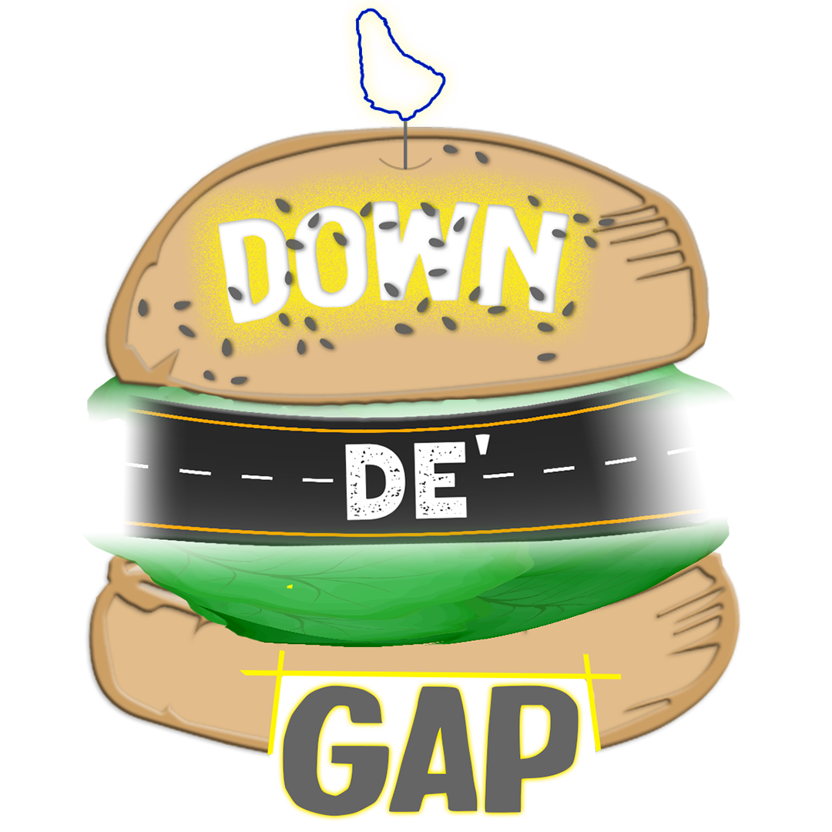
Menbers: Caleb Ellis, Chavez Bobb, Azari Gittens, Joshua Layne, Shania Walcott and Jaden Cupid
Down De’ Gap
Group Presentation
"We go down de gap, so you don't have to "

Slide 2
Contents
Introduction of Our Business | What is Our Business, Mission Statement, Why Did we choose this business venture?, what problem does our business Solve?, why is it an opportunity, features of our business
Management Team | Partners, roles
Is Our Business Feasible? | Desire and demand, target market, industry
How Will we compete in the Industry? | New Entrants, rivalry, copetitive analysis
What differentiates us from our competitors? | Basis of differenciation, core competencies, key assets
How do we plan to make money? | Revenue streams
How will we be funded? | Start up cost, Method of funding
What Marketing Strategies will be used? Ethical & Legal Issues faced. | Product, Price, Promotion, Place Ownership Structure, Code of conduct, Partners Agreement, Licensing

Slide 3
Down De’ Gap
What is Our Business ?
Down De Gap is a food directory and delivery service that hosts the menus and prices of local cuisine from small to medium sized food business around the island.
Our website acts as an intermediary between the consumer and our supplier operators.

Slide 4

Why did we choose this business?
This is an underdeveloped industry and an emerging market in Barbados as people are now becoming more acquainted with technology and are now more willing to order items through delivery. If we were to enter the market and succeed, we would have a first mover advantage as no other company would have the scale of networks and logistical operations that we would. This best describes the place our company would hold within the food sale and delivery market.

Slide 5
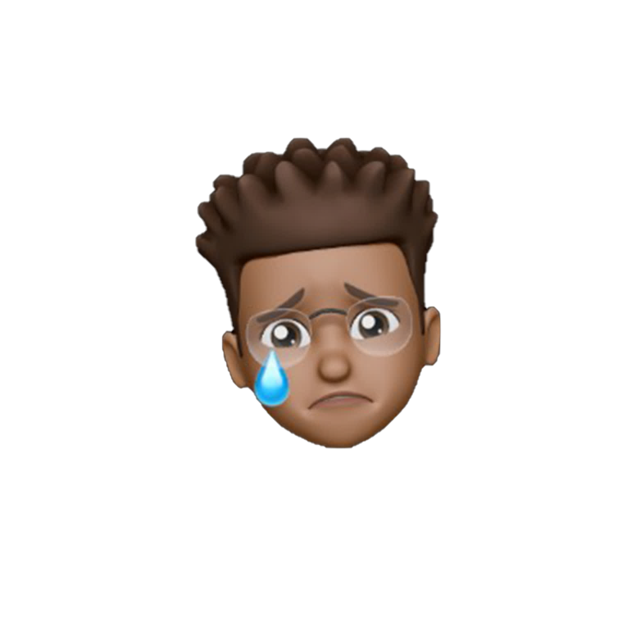
What Problem does Our Business Solve?
People don’t get a lot of options to choose from when it comes to having food delivered to them, existing delivery companies’ primarily partner with large food companies leaving the “little guy” in the wind. We intend to solve this problem by giving people a large variety of food options to choose from.

Slide 6

Why do we see it as an opportunity?
During the covid pandemic there was a significant demand for delivery services due to the many restrictions in place and the general fear of being around other persons. Even though some large food business were able to offer delivery services, most, if not all, small food business were unable to provide this service and still do not provide it to date although the demand remains constant and growing locally.
This demand eventually became a need where more persons became semi-dependent on the delivery services offered by companies like Chefette and KFC along with people still being unable to receive this service from smaller food businesses

Slide 7
Key Features

Slide 8
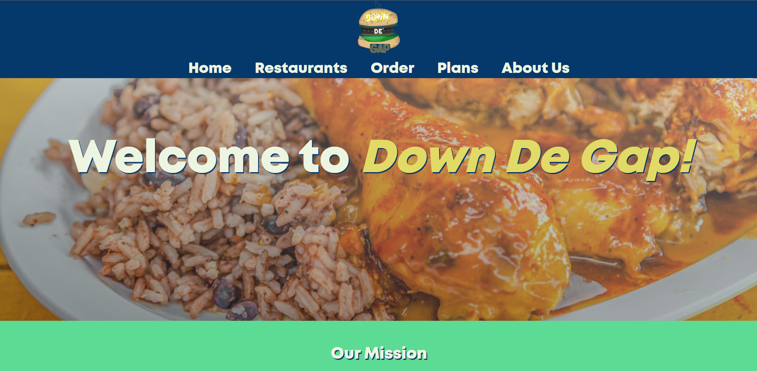
Easy to use website
Customers can order food from our suppliers from our easy to use website and can choose a delivery destination for that same website.

Slide 9

Delivery Service
With the number of drivers, we plan to have island wide, we plan to make our delivery service fast and efficient.

Slide 10
Management Team
Roles
Partners
Caleb Ellis and Joshua Layne will be simultaneously responsible for the executive leadership and webpage management of the business.
Shania Walcott and Chavez Bobb will be responsible for the social media management of the business.
Azari Gittens will be responsible for professional communication.
Jaedyn Cupid will be responsible for data management.
Our business, Down De Gap, will have six founders, these being Caleb Ellis, Joshua Layne, Azari Gittens, Shania Walcott, Chavez Bobb, and Jaedyn Cupid.

Slide 11
Is it feasible?

Slide 12
Desire and Demand for Down De’ Gap
Demand
There is very much a demand for our service, as a lot of people would prefer having home cooked meals at their disposal. Our service would give consumers a larger variety to choose from that are beneficial to them health wise. But some of the factors that hinder this are as follows:
• A lot of small food business are difficult to find.
•Their locations are through areas that are hard to get to.
•They do not deliver.
•People do not want to go out of the comfort of their homes to get something to eat.
•They get overpowered by large food companies.
•Workplace demands make it difficult for people to prepare home cooked meals
Desire
After conducting an online survey, it shows that most people prefer to order food from their community food business rather than order from large food Companies. When asked “How willing are you to purchase food from businesses that you are unaware if you were provided with their location, menu and further details?” the prominent answer was very likely. This in fact shows that there is a desire for this service.

Slide 13

T rget Market
Our company plans to deliver our service to everyone who just want a bite to eat but more specifically to consumers who craves or want home cooked meals instead of fast food. Tourists and young individuals (Gen Z & Millennials) are our main groups of focus. After conducting an online survey, the stats show that most customers purchase from small food business in their community than ordering from larger fast-food restaurants. This shows that there is a significant portion of the population who would use our service.

Slide 14
Industry
This is an underdeveloped industry and one with little to no major competition. There will not be a substantial threat from possible substitutes or alternatives as they either have different focuses or they have a less professional web presence with relatively inaccessible information. With a significant enough online presence and with easily accessible and transparent information about the services we provide, we will be seen as the best option for consumers.

Slide 15

How will we compete in this industry?

Slide 16
Counteracting Being New Entrants in the Industry?
Capital requirements and access to distribution channels could be a barrier to entry for new entrants. As there will be many businesses that one will have to contact and arrange delivery arrangements in order to have significant enough variety for consumers to choose from, it would be difficult to create a network of operators quickly and affordably.
To counteract, we will work towards having exclusive delivery dealing contracts with most of our suppliers in exchange for increased targeted promotion of their business to nearby persons and a greater portion of delivery fares. This will ensure that the networks that we build with these small operators become almost impossible to penetrate thus creating a barrier of entry.

Slide 17
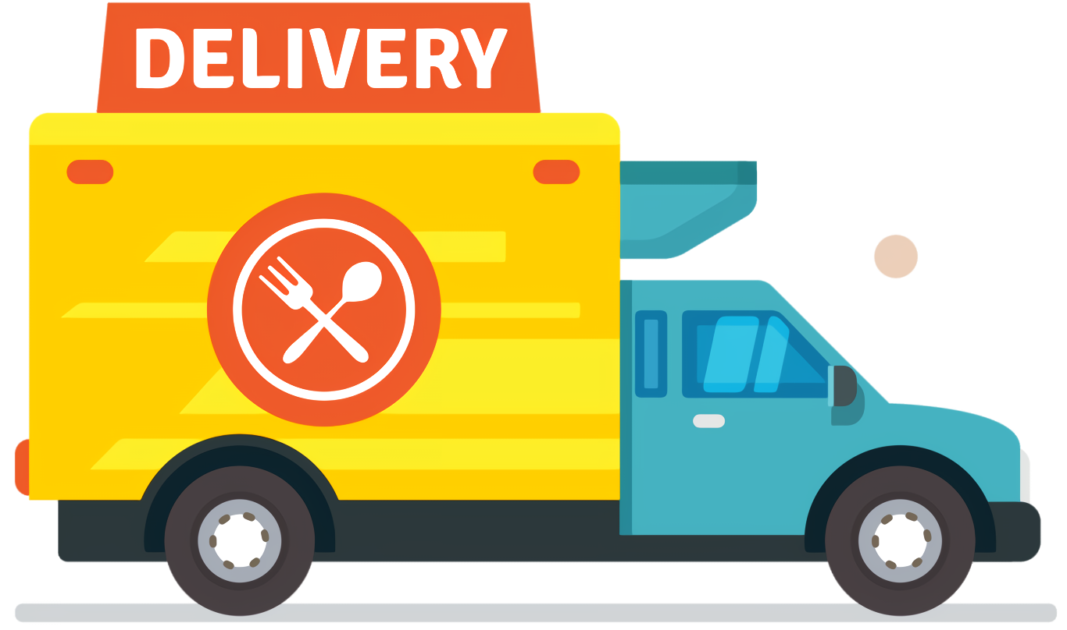
Competitors in our Industry
Rivalry
In terms of products, we believe there is more than enough difference between what we offer and what the other competition offers.
Whereas we focus on smaller food operators, most of our competitors either don't have such a focus on this clientele or aren't interested in having such a focus, thereby having a first mover advantage.
This also means industry is likely not to grow as fast as others due to the high upfront capital requirements needed to network all of these restaurants but our fixed costs of operation will likely be higher, meaning our rates may be cheaper than our competitors in order to attract consumers.

Slide 18
Competitive Analysis A graphical representation of our competition analysis for our direct local competitors is:
 | Down De’ Gap | HopScotch | Chirp Barbados | Doordash delivery
Price | Flat section based and progressive distance based (+1) | Progressive distance based (-1) | N/A (-1) | Progressive distance based (-1)
Potential Supplier Base | Small food operation businesses (+1) | Larger restaurants (-1) | N/A (-1) | Large and small food restaurants and parcel couriers (1)
Advertising and Visibility | Prominent (Planned - online and mass media) (+1) | Prominent (online only) (-0.5) | Not prominent (-1) | Not prominent (-1)
Online Presence | Website and social media (0) | Website and social media (0) | Instagram only (-1) | Instagram only (-1)
Accessibility | Online, easily accessible (0) | Online, easily accessible (0) | Not easily accessible (-1) | Not easily accessible (-1)
Score | 3 | -2.5 | -5 | -4

Slide 19

What differenciats Us From our Competitors?

Slide 20
Basis Of Differentiation
Unlike our competitors who primarily focus on large food companies around the island such as Burger King, Subway, Chutney’s etc., our company is centered on not only advertising small business around the country but providing the means for their product to get to our consumers. This gives a larger variety of options to our customers in terms of whether they want home cooked meals or fast food. The benefit to this includes having more nutritional and healthier options to choose from. In addition to having a larger variety to choose from than our competitors, our company means of delivery differs also. As we intend to hire freelance drivers around the country to deliver food for us. This feature will in turn be cheaper and much more efficient as having drivers all around the island will decrease delivery wait time.

Slide 21
Core competencies
01.
Our primary focus on small food business
This gives us a huge competitive advantage in the food industry. This is because not only are we solving a problem in the food industry in Barbados, but we are the only delivery service on the island to cater to small food businesses island wide.
User Friendly Website
02.
With our user-friendly website, it makes it very easy and efficient for our customers to use. The website features most of the small food business around Barbados and the products/food that they offer. Placing an order has never been made easier.
Our customer service
We intend to have customer service support available throughout operational hours to customers who might experiencing difficulties with our service. In addition to this customer support employees will be trained on how to talk and deal with customers respectfully.
03.
Delivery time
With the number of drivers our company will have around the island, this will make it easier and faster for customers to receive their food. With having drivers at hand will decrease the distance cost and wait time customers would have to otherwise endure.
04.

Slide 22


Key Assets
Freelance Drivers
Partnership with small food busiensses
Down the Gap intends to hire freelance drivers all around the island to do delivery for us. This feature will save the company not only money but also encourage positive customer feedback.
How?
Well by having drivers all around the island located in different parishes, it decreases the delivery time of customers having to wait on their food. This also aids with customer retention.
As mentioned before, we will be having exclusive delivery dealing contracts with most of our suppliers. This will ensure that the networks that we build with these small operators become almost impossible to penetrate thus creating a barrier of entry.

Slide 23

How Do we plan to make money?

Slide 24
Revenue Streams
Partnership with Our suppliers
Delivery service
This will be our main source of revenue. having freelance drivers all over the island to deliver to customers will have a huge impact on our financial state. This feature will save us thousands of dollars because we would not need to purchase our own vehicles. In addition to saving money, it will also earn us, our delivery rates will vary based the location of the food business that is being ordered from and customers location. Hence having fair and suitable prices.
We intend to have partnerships with small food business around the island who wants to use our service. We will advertise their business on our website and in turn we take a percentage of every food order that is ordered from our website.

Slide 25
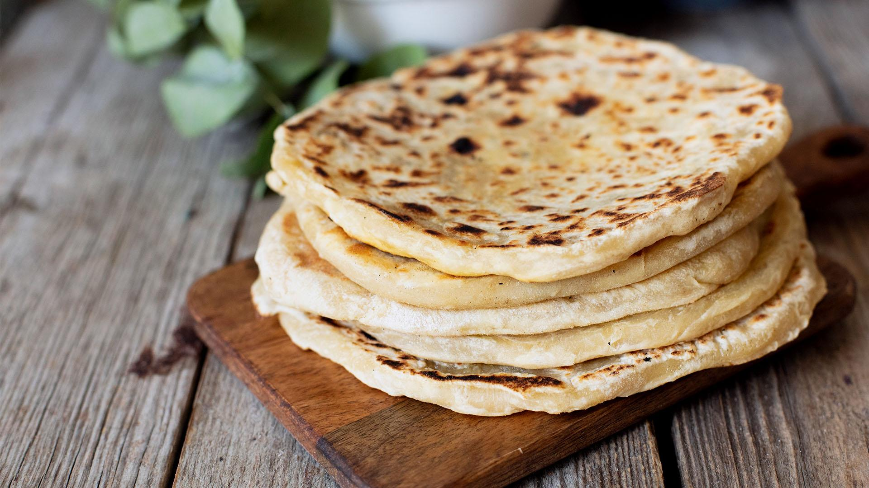
How will our business be funded?

Slide 26
Estimated start – Up Cost
Advertisements
Employees
60k
transportation
Gas bills

Slide 27
Method of Funding
Why this medthod?
Bootstrapping
We have decided that using these strategies would be the most efficient for funding since they allow use to cut costs and to avoid having to repay any loans, as well as interest. We are certain that this plan can work as our government has a program in place for small businesses that allow them to apply for grant. We are confident that if we were to apply, we would be allowed the grant. And, if the grant does not provide us with sufficient funds, we will also have our own personal funds to fall back on, which should be more than enough to reach our financial goal.
We will also be utilizing the bootstrapping method of funding to try to cut down on cost. By purchasing used vehicles instead of new ones, or even hiring people who own their own vehicle, we can reduce the amount of money needed. In terms of advertising, we would make use of the radio station in the country, as well as making use of social media platforms as means of promoting our business. This allows us to reach people who reside all over the island who may potentially be interested in our service.

Slide 28

How will the business be marketed?

Slide 29
Product
Down De’ Gap’s main services include advertising and recommending food business and delivering food and related items to clients.
So that the company is able to obtain market share and differentiate its service from competitors, we aim to :
Offer discounts with consistent use
Provide a social media friendly interface where users will be able to see client reviews and trending restaurants and dishes
This is done to attract customers and encourage them to continue to use our service by building trust and brand loyalty through targeting customer satisfaction.

Slide 30
Price
To garner public interest and allow the company to appropriately compete in the market, Down De’ Gap intends to charge modestly below market value but increase pricing gradually as our consumer base increase to match current market value.
Cost based pricing will be used to fairly charge for distance travelled and time taken while also reducing costs where wait times were unreasonable.
Using this strategy accompanies the risk of making little to no profit in the earlier stages of the business. To compensate for this, we plan to establish customer retention and loyalty through:
Providing in-depth and helpful information to users
Creating and be active in related communities
Utilizing reference accounts

Slide 31
Promotion
The business will be promoted primarily via low-cost strategies like social media and guerilla marketing.
Social media will be used by creating and frequently posting to official business accounts established on Twitter, Facebook and Instagram. Deals, specials and discounts will be actively disclosed to follower and the company will eagerly interact within these communities. This is done to create a vibrant community and achieve high levels of engagement.
Guerilla Marketing will be used to ensure that we stand out and gain attention at a relatively low cost. It will primarily be done in high – medium traffic areas such as malls. Partners will traverse while wearing company shirts and actively engage with the public in order to spread general information about the business. To ensure that we entice potential consumers we will aim to hand out limited time coupons which will prompt people to make their first purchase. Eye-catching posters and displays will also be used to catch attention towards the business.

Slide 32
Place
Down De Gap will offer its services to clients directly through an online medium being a webpage. This comes with issues as the maintenance and cost of the website falls upon the partners of the company.
The cost of the website can be circumvented by placing advertisement of complementary services and products from other businesses to procure additional income.

Slide 33


Ethical & Legal Issues

Slide 34
Code of Conduct
01.
Honesty & Integrity
All staff should ensure that the business operations, applications for services and staff recruitment are dealt with in an open, fair and impartial manner at all times.
Down De’ Gap’s code of conduct directs partners and employees on making just decisions and solving problems.
The code clearly sets the ethics of the business and should be used as a guide in carrying out daily activities while at the company.
The code follows core principles of Honesty & Integrity, Respect, Equal Opportunities and Safety.
Respect
Staff must exhibit respect towards each other as professionals at all times. Down De Gap is fully committed to uploading internationally recognised human rights of all people. Discrimination, sexual harassment, retaliation, or intimidation of any kind is not tolerated.
02.
Equal Opportunities
Down De Gap ensures that all employees are presented with equal opportunities regardless of sex, race, colour, religion, nationality, age, disability, or any other legally protected status. This applies to all aspects of business.
03.
Safety
Down De Gap is committed to and illness and injury free working environment that is in compliance with all relevant laws and regulations that protect worker safety.
04.

Slide 35
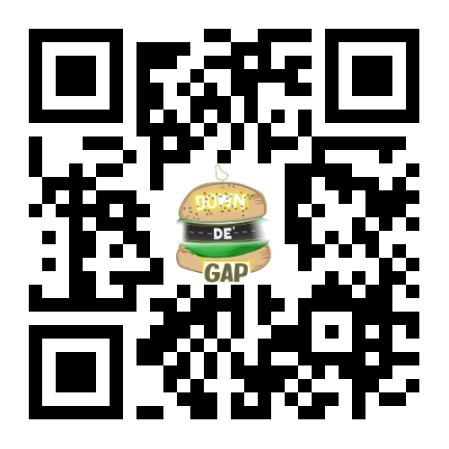
Ownership Structure
A partnership will be established for the business concept as it provides the following benefits:
Its easy to establish
Has low start-up costs
More capital is made available for the business as its easier to raise funds with more owners
Easier to change legal structure as circumstances change
Partners business affairs are private
With the current resources (financial, skills, etc.) available a partnership was the most suitable option over sole proprietorship and corporations.
Attached in the QR code is the draft for the partnership agreement.

Slide 36
Licensing
A Merchandise and Character license will be necessary for the business (so that name of the business can be properly claimed) along with a health certificate/ operating license provided by the Ministry of health of Barbados.

Slide 37
Thank You!

